Slide 1

Heuristic Search Algorithm
(Informed Search)
Artificial Intelligence
School of Computing
Universiti Teknologi Malaysia
Notes:
https://www.sciencedirect.com/book/9780123725127/heuristic-search#book-description
https://www.sciencedirect.com/topics/computer-science/heuristic-search-algorithm

Slide 2
Outline
What is Heuristic Search?
Selection of a Search Strategy
  Hill climbing Search
  Best-first Search
  Search with Heuristic
  Comparison of all search strategy
Heuristic Evaluation Function f(n)
Exercise
Notes:
https://data-flair.training/blogs/heuristic-search-ai/

Slide 3
What is Heuristic Search?
  Definition
  Taxonomy of Heuristic Search

Slide 4
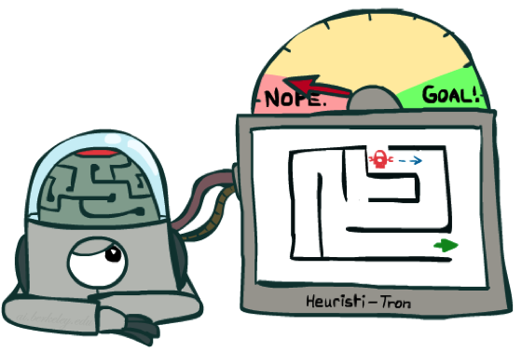
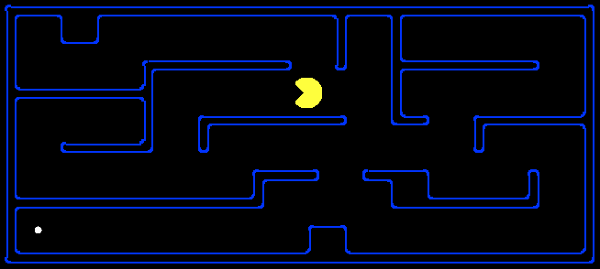
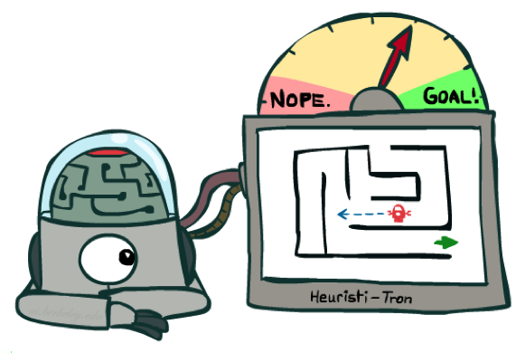
Heuristic Search: Definition
A heuristic is:
  A function that estimates how close a state is to a goal
  Designed for a particular search problem
  Examples: Manhattan distance, Euclidean distance for path
10
5
11.2

Slide 5
Heuristic Search: Definition
A technique to solve a problem faster than classic methods, or to find an approximate solution when classic methods cannot.
Heuristic is a rule of thumb that probably leads to a solution. Heuristics play a major role in search strategies because of exponential nature of the most problems. Heuristics help to reduce the number of alternatives from an exponential number to a polynomial number
This is a kind of a shortcut as we often trade one of optimality, completeness, accuracy, or precision for speed.
A Heuristic (or a heuristic function) takes a look at search algorithms. At each branching step, it evaluates the available information and makes a decision on which branch to follow. It does so by ranking alternatives. The Heuristic is any device that is often effective but will not guarantee work in every case.

Slide 6
Heuristic Search: Definition
(rules of thumb): Weak search method because it is based on experience or intuition.
Have long been a core concern in AI research
Used to prune spaces of possible solution
When to employ Heuristic?
  A problem may not have an exact solution.
    e.g. medical diagnosis: doctors use heuristic
  A problem may have an exact solution, but the computational cost of finding it may be prohibitive.
    e.g in chess (exhaustive or brute force search)

Slide 7
Heuristic Search: Taxonomy
Heuristic Search
Weak Techniques
Direct Techniques
Breadth First Search (BFS)
Depth First Search (DFS)
Best-First Search
A* Search
Bidirectional Search
Tabu Search
Beam Search
Simulated Annealing
Hill Climbing
Constraint Satisfaction Problems

Slide 8
Heuristic Search: Taxonomy
Direct Heuristic Search Techniques
Other names for these are Brute Force Search, Blind Search, Uninformed Search, and Blind Control Strategy.
These aren’t always possible since they demand much time or memory. They search the entire state space for a solution and use an arbitrary ordering of operations.
Weak Heuristic Search Techniques
Other names for these are Informed Search, Heuristic Search, and Heuristic Control Strategy
These are effective if applied correctly to the right types of tasks and usually demand domain-specific information.
This extra information is needed to compute preference among child nodes to explore and expand. Each node has a heuristic function associated with it.
Examples of these are Breadth First Search (BFS) and Depth First Search (DFS).
Examples are Best First Search (BFS) and A*.

Slide 9
Direct Heuristic Search
  Introduction
  Anagram
  Breadth First Search (BFS)
  Depth First Search (DFS)
  Quiz

Slide 10
Direct Heuristic Search: Intro
Other names for these are brute force search, blind search, uninformed search, and blind control strategy
In computer science, a brute force search consists of systematically enumerating every possible solution of a problem until a solution is found, or all possible solutions have been exhausted.
For example, an anagram problem can be solved by enumerating all possible combinations of words with the same number of letters as the desired phrase, and checking one by one whether the words make a valid anagram.

Slide 11
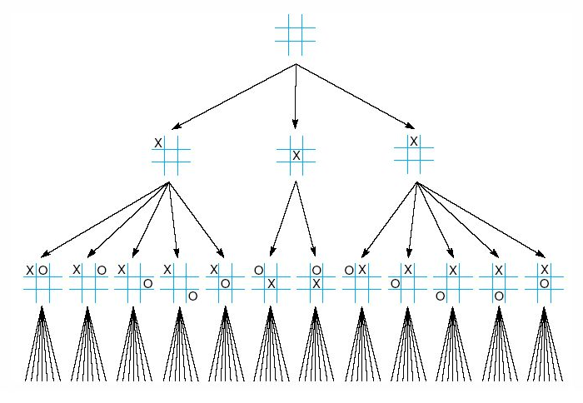
Direct Heuristic Search: Intro
eg: To Reduce search
First three levels of the tic-tac-toe state space reduced by symmetry (simple heuristic-most winning opportunities)
Notes:
https://www.thewordfinder.com/anagram-solver/

Slide 12
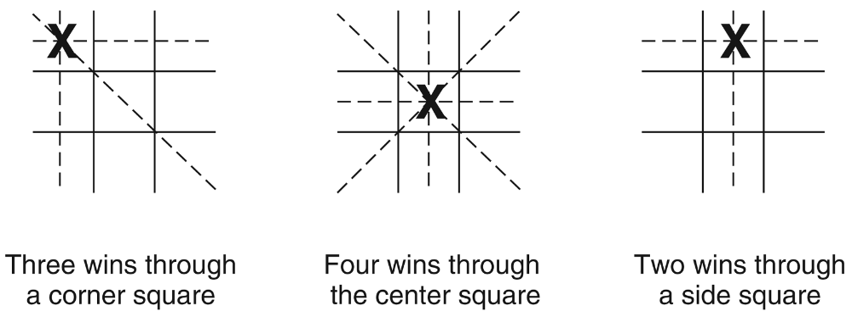
Direct Heuristic Search: Intro
The “most wins” heuristic applied to the first children in tic-tac-toe.
Notes:
https://www.thewordfinder.com/anagram-solver/

Slide 13
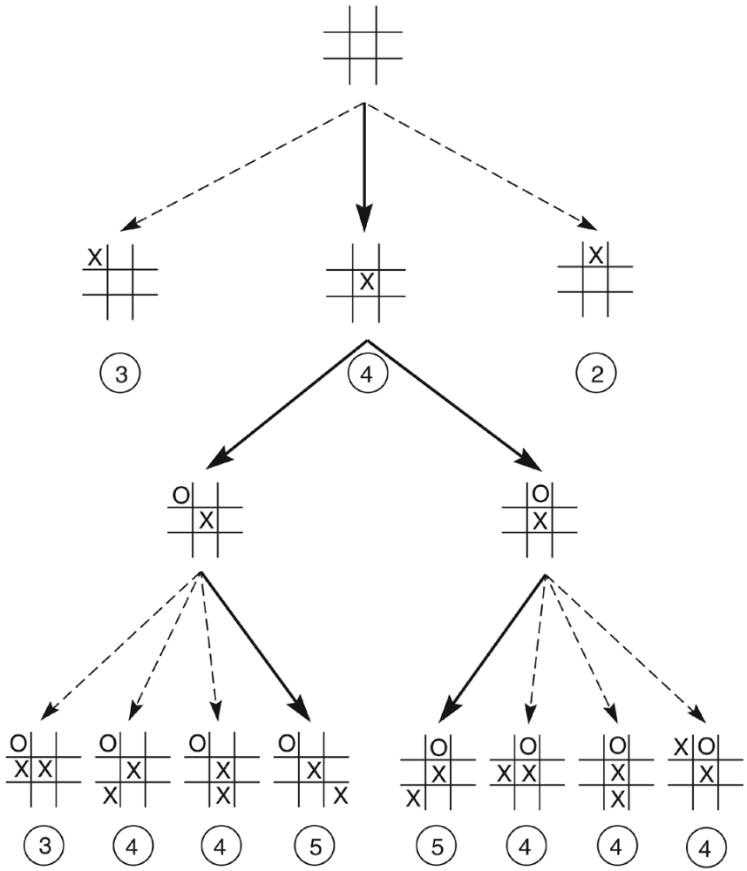
Direct Heuristic Search: Intro
Heuristically reduced state space for tic tac toe.
Notes:
https://www.thewordfinder.com/anagram-solver/

Slide 14
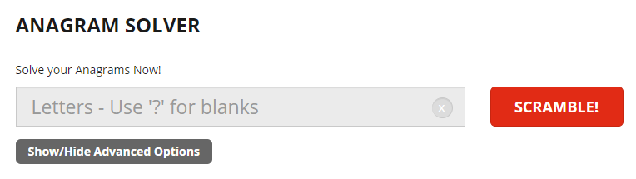

Direct Heuristic Search : Anagram
A word that is spelled with the exact same letters as another word. Example: RIDES is an anagram of SIRED and vice versa
Notes:
https://www.thewordfinder.com/anagram-solver/

Slide 15
Breadth First Search (BFS)
Breadth-first search (BFS) is a method for exploring a tree or graph. In a BFS, you first explore all the nodes one step away, then all the nodes two steps away, etc.
Breadth-first search is like throwing a stone in the center of a pond. The nodes you explore "ripple out" from the starting point.
BFS is a traversing algorithm where you should start traversing from a selected node (source or starting node) and traverse the graph layer wise thus exploring the neighbor nodes (nodes which are directly connected to source node). You must then move towards the next-level neighbor nodes.
As the name BFS suggests, you are required to traverse the graph breadthwise as follows:
  First move horizontally and visit all the nodes of the current layer
  Move to the next layer

Slide 16
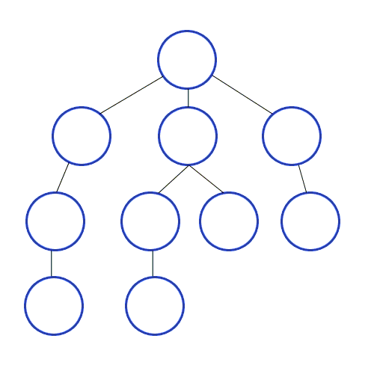
Breadth First Search (BFS)
Advantages:
A BFS will find the shortest path between the starting point and any other reachable node. A depth-first search will not necessarily find the shortest path
Disadvantages
A BFS on a binary tree generally requires more memory than a DFS
Notes:
https://www.interviewcake.com/concept/java/bfs

Slide 17
Depth First Search (DFS)
Depth-first search (DFS) is a method for exploring a tree or graph. In a DFS, you go as deep as possible down one path before backing up and trying a different one.
Depth-first search is like walking through a corn maze. You explore one path, hit a dead end, and go back and try a different one.

Slide 18
Depth First Search (DFS)
Advantages
Depth-first search on a binary tree generally requires less memory than breadth-first
Depth-first search can be easily implemented with recursion
Disadvantages
A DFS doesn't necessarily find the shortest path to a node, while breadth-first search does

Slide 19
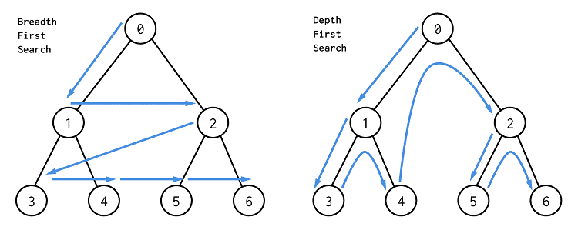
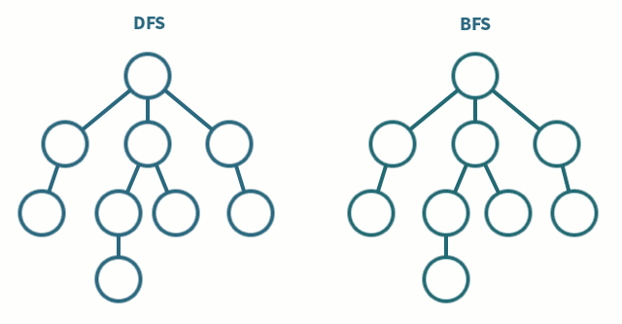
DFS vs BFS
List down all the differences between DFS and BFS

Slide 20
Weak Heuristic Search
  Hill climbing Search
  Best-first Search
  A* Search

Slide 21
Hill Climbing
Simplest, the best child is selected for further expansion
Limited memory, no backtracking and recovery
Problem with hill climbing:
  An erroneous heuristic can lead along an infinite paths that fail.
  Can stuck at local maxima reach a state that is better evaluation than its children, the algorithm halts.
  There is no guarantee optimal performance
Advantage
  Can be used effectively if the heuristic is sufficient

Slide 22
Hill Climbing
Here the generate and test method is augmented by an heuristic function which measures the closeness of the current state to the goal state.
  Evaluate the initial state if it is goal state quit otherwise current state is initial state.
  Select a new operator for this state and generate a new state.
  Evaluate the new state
    if it is closer to goal state than current state make it current state
    if it is no better ignore
  If the current state is goal state or no new operators available, quit. Otherwise repeat from 2.
In the case of the four cubes a suitable heuristic is the sum of the number of different colours on each of the four sides, and the goal state is 16 four on each side. The set of rules is simply choose a cube and rotate the cube through 90 degrees. The starting arrangement can either be specified or is at random.

Slide 23
Hill Climbing: Type
Simple Hill climbing
Steepest-Ascent Hill climbing
Stochastic hill climbing
It examines the neighboring nodes one by one and selects the first neighboring node which optimizes the current cost as next node.
It first examines all the neighboring nodes and then selects the node closest to the solution state as of next node.
It does not examine all the neighboring nodes before deciding which node to select .It just selects a neighboring node at random and decides (based on the amount of improvement in that neighbor) whether to move to that neighbor or to examine another.

Slide 24
Hill Climbing: Issues
Local Maximum
Plateau
Ridge
All neighboring states have values worse than the current. The greedy approach means we won’t be moving to a worse state. This terminates the process even though there may have been a better solution. As a workaround, we use backtracking.
All neighbors to it have the same value. This makes it impossible to choose a direction. To avoid this, we randomly make a big jump.
At a ridge, movement in all possible directions is downward. This makes it look like a peak and terminates the process. To avoid this, we may use two or more rules before testing.

Slide 25
Best First Search
It is a general algorithm for heuristically searching any state space graph
Supports a variety of heuristic evaluation functions
Better and flexible Algorithm for heuristic search
Avoid local maxima, dead ends; has open and close lists
selects the most promising state
apply heuristic and sort the ‘best’ next state in front of the list ( priority queue ) can jump to any level of the state space
If lead to incorrect path, it may retrieve the next best state

Slide 26
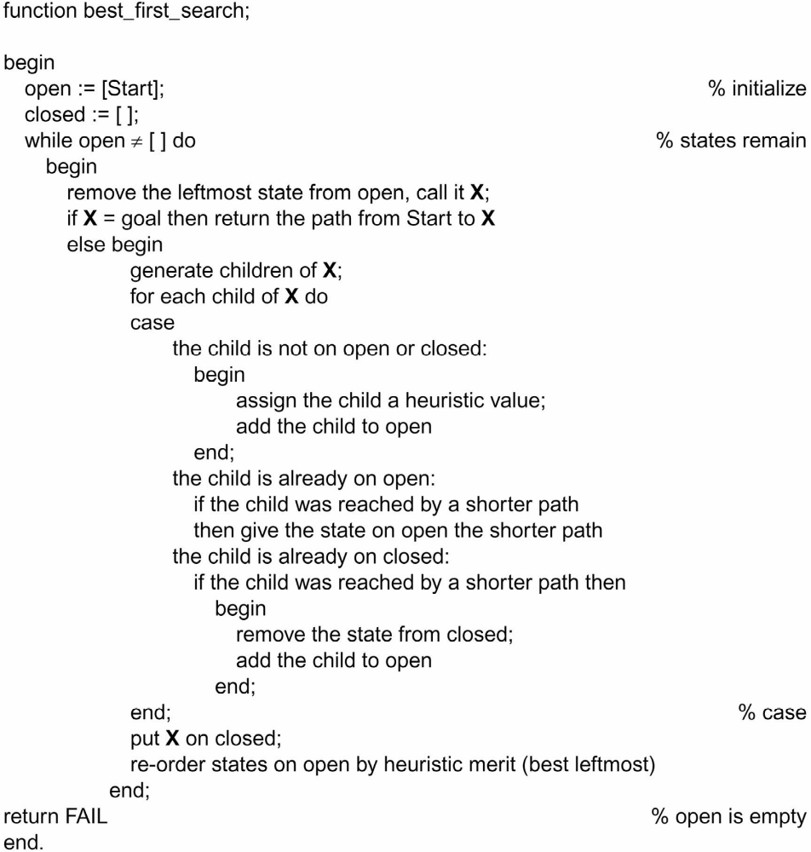
Best First Search

Slide 27
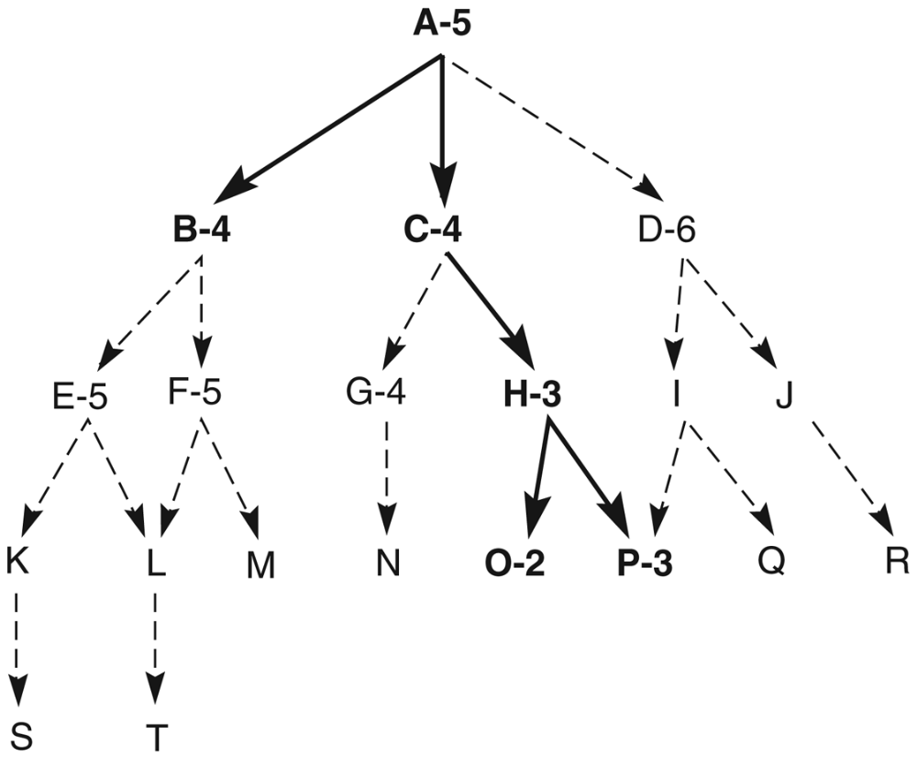
Best First Search

Slide 28
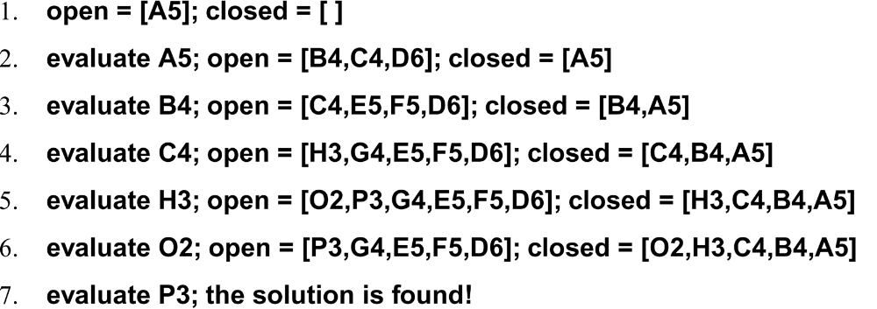
Best First Search

Slide 29
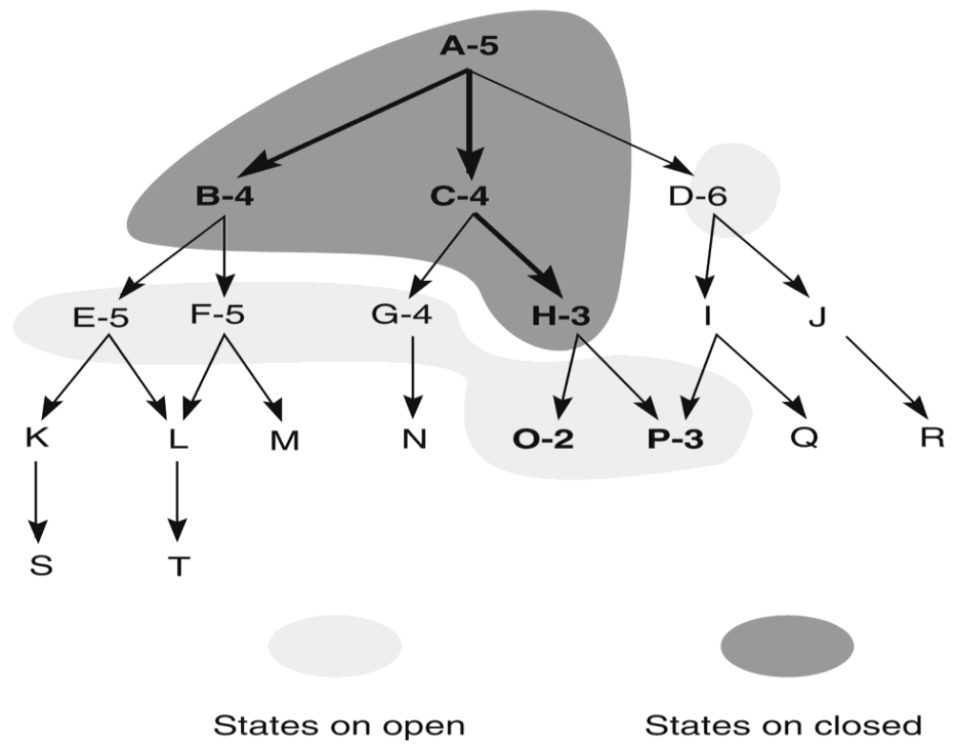
Best First Search
Heuristic search of a hypothetical state space with open and closed states highlighted.

Slide 30
A* Search
What is A* Search Algorithm?
  A* Search algorithm is one of the best and popular technique used in path-finding and graph traversals.
Why A* Search Algorithm?
  Informally speaking, A* Search algorithms, unlike other traversal techniques, it has “brains”. What it means is that it is really a smart algorithm which separates it from the other conventional algorithms.
  Many games and web-based maps use this algorithm to find the shortest path very efficiently (approximation).
Notes:
https://www.geeksforgeeks.org/a-search-algorithm/

Slide 31
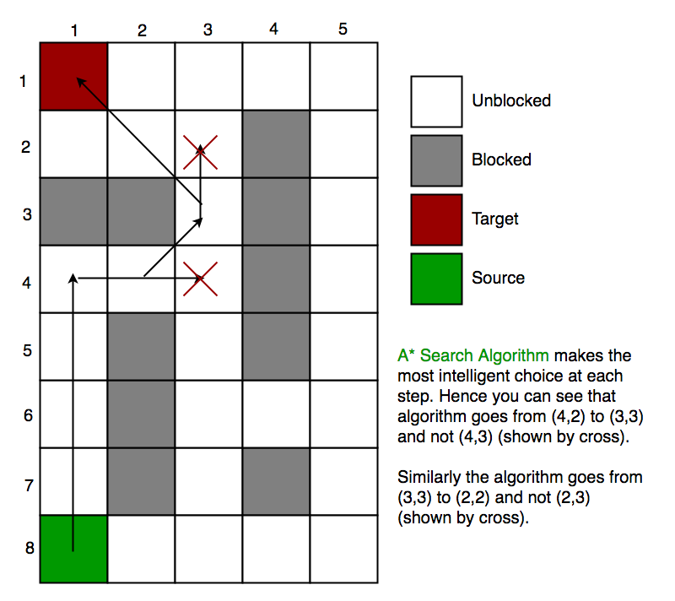
A* Search
Approximation Heuristics
There are generally three approximation heuristics to calculate h
Manhattan Distance
Diagonal Distance
Euclidean Distance
Notes:
https://www.geeksforgeeks.org/a-search-algorithm/

Slide 32
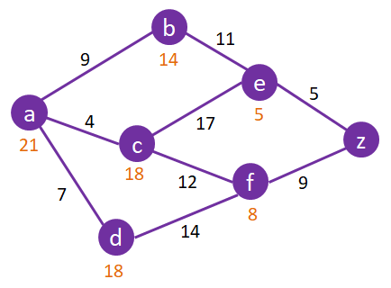
A* Search
What is the shortest path to travel from a to z?

Slide 33
Heuristic Evaluation Function f(n)

Slide 34
Heuristic Evaluation Function f(n)
To evaluate performances of heuristics for solving a problem
Devise good heuristic using limited information to make intelligent choices
To better heuristic, f(n)=g(n)+h(n), where h(n) distance from start to n, g(n) is distance from n to goal
Eg. 8 puzzle, heuristics h(n) could be:
  No. of tiles in wrong position
  No. of tiles in correct position
  Number of direct reversal (2X)
  Sum of distances out of place
And g(n) is the depth measure

Slide 35
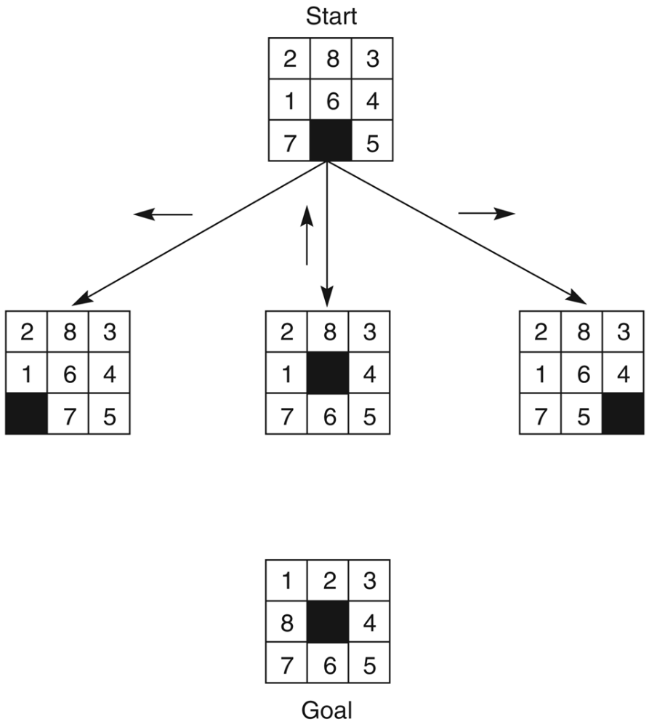
Heuristic Evaluation Function f(n)
The start state, first set of moves, and goal state for an 8-puzzle instance.
f(n) = g(n) + h(n)
g(n) = actual dist. From n to start
h(n) = no. of tiles in wrong position
g(n)=0
g(n)=1

Slide 36
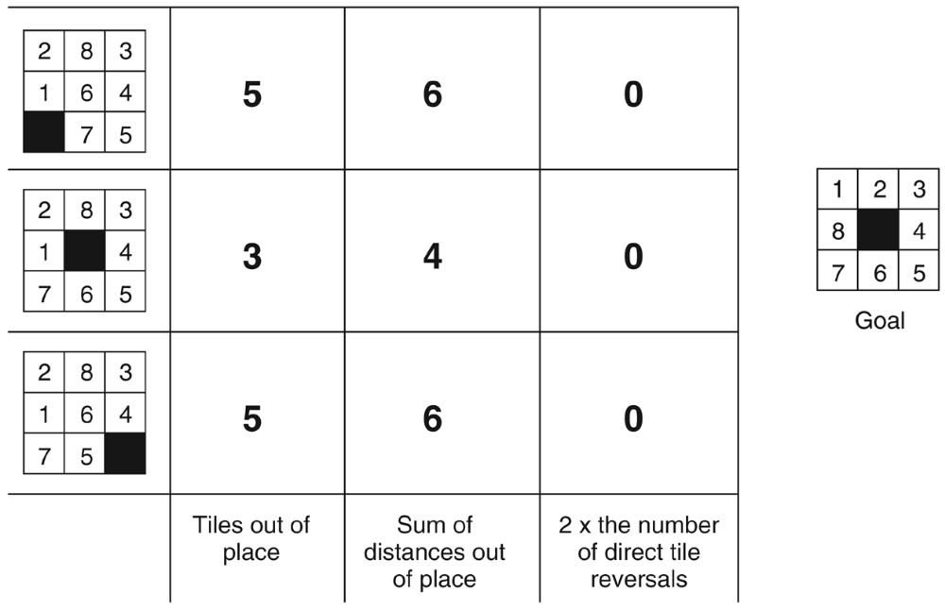
Activity: Heuristic Evaluation Function f(n)
Three heuristics applied to states in the 8 puzzle
Devising good heuristics is sometimes difficult; OUR GOAL is to use the limited information available to make INTELLIGENT CHOICE
Use formula as follows:
f(n) = g(n) + h(n)
g(n) = actual dist. From n to start
h(n) = no. of tiles in wrong position
g(n) = ?
?
?
?
?
g(n) = ?
g(n) = ?
?
?
h(n)
f(n)

Slide 37
Heuristic Evaluation Function f(n)
Three heuristics applied to states in the 8 puzzle
Devising good heuristics is sometimes difficult; OUR GOAL is to use the limited information available to make INTELLIGENT CHOICE
Use formula as follows:
f(n) = g(n) + h(n)
g(n) = actual dist. From n to start
h(n) = no. of tiles in wrong position
g(n) = 1
g(n) = 2
g(n) = 3
h(n)
f(n)

Slide 38
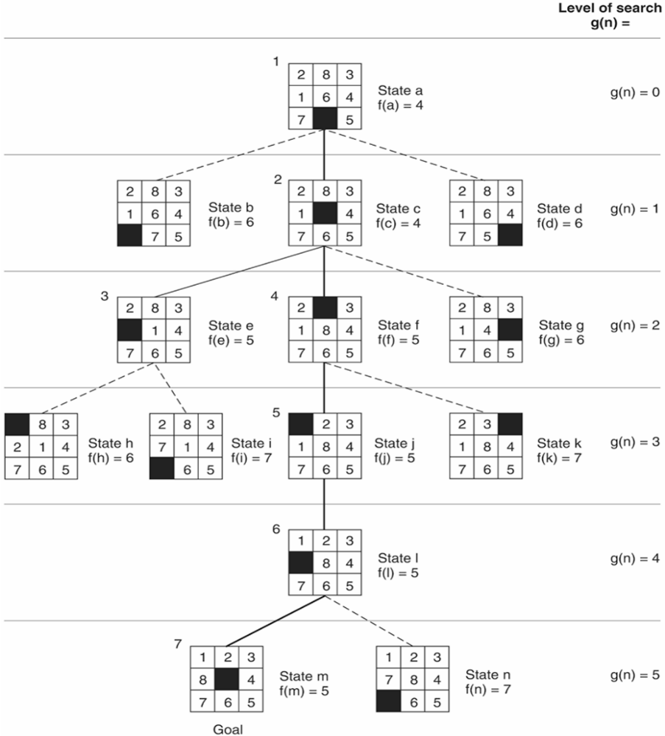
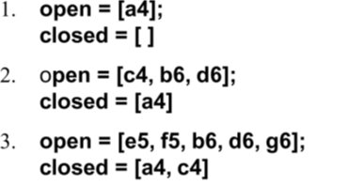
Activity: Open & Closed states
In the tree of 8 puzzle given in the next slide, Give the value of f(n) for each state, based on g(n) and h(n)
Trace using best first search, what will be the lists of open and closed states? Complete the lists below until successfully achieving the goal.
f(n) = g(n) + h(n)
g(n) = actual dist. From n to start
h(n) = no. of tiles in wrong position

Slide 39
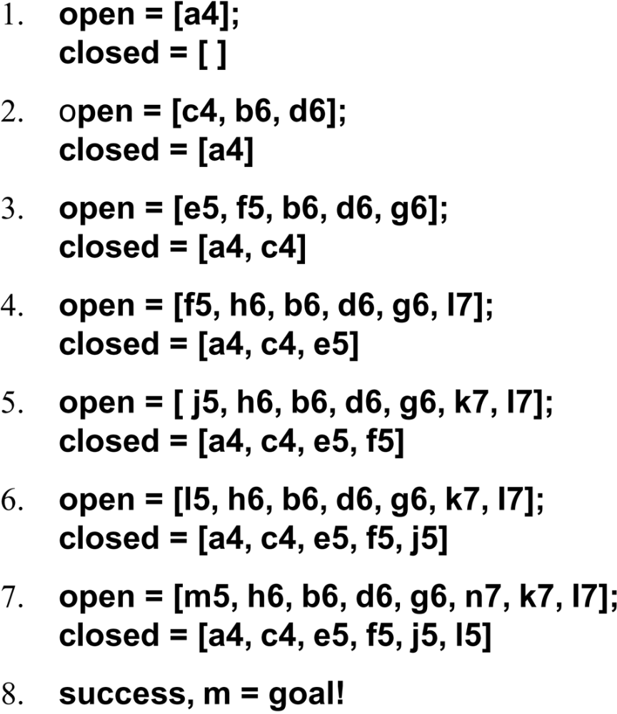
Answer: Open & Closed states
The successive stages of open and closed that generate previous graph are:

Slide 40
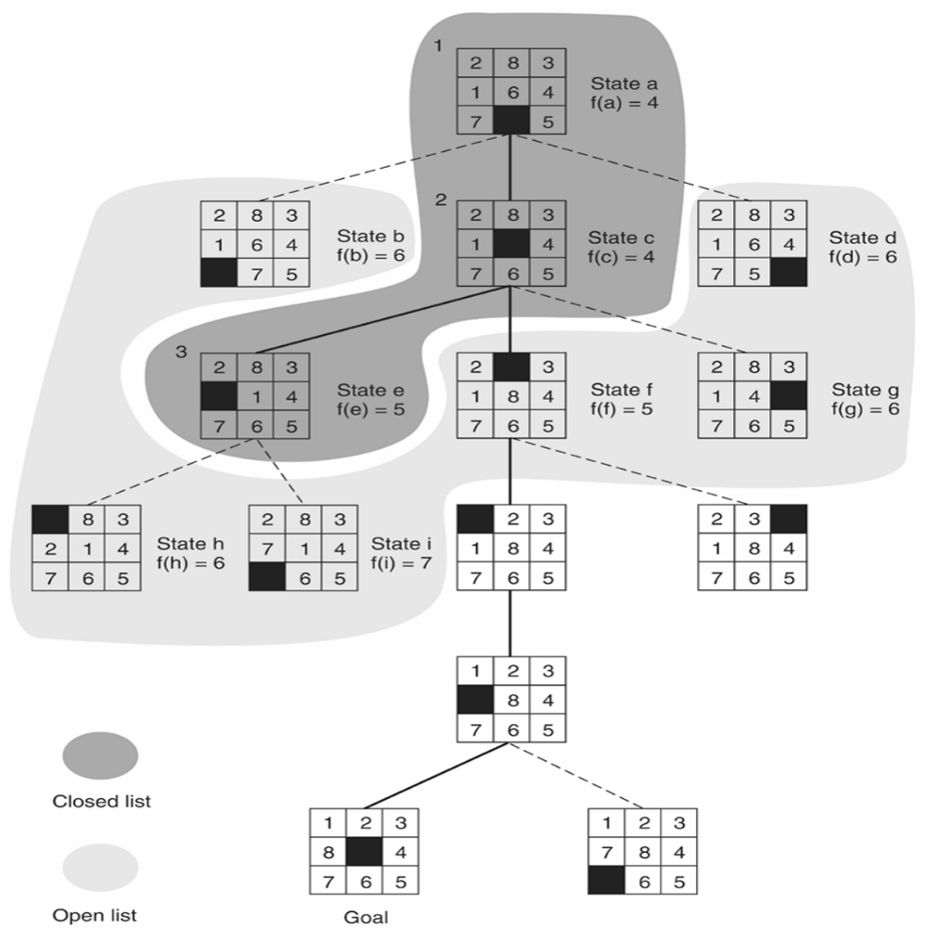
Activity: Evaluate f(n)
Open and closed as they appear after the third iteration of heuristic search.
Evaluate why from the current state e5, this algorithm moves to f5 but not i7 in the next step.
Notes:
Calculate f(f5) = 3 + 2 = 5
Calculate f(i7) = 4 + 4 = 8
Since f(f5) has a lower value of 5 than i7, thus next is move is to f5

